Slide 1
Recursion
TIP101
Notes:
🌟 Purpose: Welcome students and introduce the session's focus on recursion.
✅ What should I be doing?
Greet students warmly and set a positive tone for the session.
🎙 What should I be saying?
Welcome to Week 7 of TIP101! Today, we’re diving into recursion, one of the most powerful tools in programming.
🙌🏽 How should I engage students?
Use humor or compliments: "Let’s see those bright smiles! Who’s ready for recursion today?"

Slide 2
1 | Welcome 👋🏽 | 10 minutes
2 | Recursion | 35 minutes
3 | BREAK | 5 minutes
4 | Collaborative Problem Solving | 60 minutes
5 | Wrap Up | 10 minutes
Notes:
🌟 Purpose: Provide an overview of the session structure and timing.
✅ What should I be doing?
Walk through the agenda to set expectations for the session.
🎙 What should I be saying?
Here’s what we’ll be covering today. We’ll start with an introduction to recursion and work through some examples. After a short break, we’ll dive into collaborative problem solving before wrapping up with reflections and reminders.
The goal is to ensure that by the end of today, you’ll have a solid understanding of how recursion works and where it can be applied.
🙌🏽 How should I engage students?
Ask: "Does anyone have any questions about today’s agenda or what we’ll be focusing on?"
Encourage: "If there’s anything specific you’d like to cover, let me know, and we’ll make sure to address it."

Slide 3
Welcome! 👋🏽
10 minutes

Slide 4


Turn on your cameras
Fill out the entry ticket
Notes:
🌟 Purpose: Encourage visual engagement to foster connection during the session.
✅ What should I be doing?
Prompt students to enable their cameras and submit the entry ticket.
🎙️ What should I be saying?
Let’s kick off our session by turning on our cameras!
Also, don’t forget to fill out the entry ticket to help us organize breakout rooms later.
🙌🏽 How should I engage students?
Use humor or compliments: "Let’s see those smiles!"
Acknowledge and thank students who turn on their cameras.

Slide 5
5 minutes
🌞Question:
If you could had to choose between only seeing the sunrise or only seeing the sunset, which would you choose and why?
💬Answer:
Share your answer in the Zoom chat below. What kinds of pets do you have if any? If you don’t have any, share what type you would like to have, if any.

Slide 6
Mock interviews were a hit!
Students feeling confident after watching their peers
- Timing is tight on interview days
- Students looking for additional mock interview opportunities.
Notes:
🌟 Purpose: Share feedback from the previous session and highlight areas of success and improvement.
✅ What should I be doing?
Summarize feedback from the previous session's survey and present key takeaways.
🎙️ What should I be saying?
From your feedback, it seems many of you enjoyed [highlighted aspect]. One suggestion was [area for improvement]. We’ll work on that today.
🙌🏽 How should I engage students?
Ask: "Does anyone have additional feedback or suggestions?"

Slide 7

Announcements
Peer to Peer Mock Interviews
All students will participate in 2 rounds.
1 as the interviewer
1 as the interviewee
Students must be camera ready and able to share their screen while solving the problem on VS Code.
Questions will be shared a little bit ahead of time.

Slide 8
Tool: VS Code Live Share
Real-time collaboration - see your peers’ edits live on your device!
VS Code Live Share is available through a VS Code Extension -
How to install a VS Code extension
VS Code Live Share Extension
Note: We expect screen sharing in rooms, even if you utilize VS Code Live Share. During technical interviews, you may be asked to screen share, pair program using a collaborative editor like Live Share, or both. Screen sharing also helps CodePath staff quickly catch up on your progress in breakout rooms without interrupting your workflow.

Slide 9
Recursion
35 minutes

Slide 10
Recursion is when a method calls itself.
The base case is the instance where a recursive method will return a value rather than calling itself.
def recursive_sum(num):
if num <= 1:
return num
return num + recursive_sum(num - 1)
# Example usage
result = recursive_sum(5)
print(result) # Output will be 15
The recursive case is the instance where the recursive method calls itself.
Notes:
🌟 Purpose: Introduce recursion as a concept and explain its key components.
✅ What should I be doing?
Define recursion and explain the difference between the base case and the recursive case.
🎙 What should I be saying?
Recursion is when a method calls itself to solve smaller instances of the same problem. It’s like breaking a big problem into smaller, manageable chunks.
There are two key parts to any recursive function: the base case, which stops the recursion, and the recursive case, where the function calls itself.
🙌🏽 How should I engage students?
Ask: "Can anyone share an example of where they’ve seen recursion used before, even if it’s just conceptually?"

Slide 11
def recursive_sum(num):
if num <= 1:
return num
return num + recursive_sum(num - 1)
The base case comes from the part of the iterative method that stops the repetition. It occurs when a certain condition is met.
What happens when we forget the base case?
def iterative_sum_while(num):
total = 0
while num > 0:
total += num
num -= 1
return total
Notes:
🌟 Purpose: Explain the base case and its importance in recursion.
✅ What should I be doing?
Highlight the base case in the example provided and explain its role.
🎙 What should I be saying?
The base case is the condition that ends the recursion. Without a base case, the function would call itself indefinitely, leading to a stack overflow error.
In our example, the base case is when num <= 1. At this point, the function simply returns the value without making another recursive call.
🙌🏽 How should I engage students?
Ask: "Why do you think it’s critical to have a base case? What might happen if we forget to include one?"

Slide 12
def recursive_sum(num):
if num <= 1:
return num
return num + recursive_sum(num - 1)
The recursive case is the part of the iterative method that repeats.
def iterative_sum_while(num):
total = 0
while num > 0:
total += num
num -= 1
return total
Notes:
🌟 Purpose: Explain the recursive case and how it enables the function to solve the problem.
✅ What should I be doing?
Walk through the recursive case in the example provided.
🎙 What should I be saying?
The recursive case is where the function calls itself to solve a smaller part of the problem. In our example, num + recursive_sum(num - 1) keeps reducing num until it reaches the base case.
This repeated calling and combining of results is what makes recursion so powerful.
🙌🏽 How should I engage students?
Ask: "What do you think happens to the function’s state as it keeps calling itself? How does it ‘remember’ what to return?"

Slide 13
The recursive call has its own set of local variables, including the formal parameters.
def recursive_sum(num):
if num <= 1:
return num
return num + recursive_sum(num - 1)
# Example usage
result = recursive_sum(5)
print(result) # Output will be 15
The parameter values capture the progress of a recursive process, just like how loop control variables capture the progress of a loop.
Notes:
🌟 Purpose: Explain how recursion progresses by using local variables and formal parameters to keep track of the state of each recursive call.
✅ What should I be doing?
Walk through the example code, emphasizing how each recursive call creates its own copy of local variables.
Highlight the significance of the parameter num in tracking the progress of the recursion.
🎙 What should I be saying?
In recursion, each call to the function creates its own set of local variables, including the formal parameters. These variables are unique to each function call and help the recursion progress.
Here’s an example function, recursive_sum, which calculates the sum of numbers from num down to 1. The base case is if num <= 1, where the function stops and returns the value of num.
In the recursive case, the function returns num + recursive_sum(num - 1). Each call decreases the value of num by 1, capturing the progress of the recursion, just like how loop control variables track the progress in an iterative approach.
For example, if we call recursive_sum(5), the first call will handle num = 5, the second call will handle num = 4, and so on until num = 1, where the recursion ends.
The output of recursive_sum(5) is 5 + 4 + 3 + 2 + 1, which equals 15.
🙌🏽 How should I engage students?
Ask: "Can you see the connection between recursion and a loop? How does the parameter num function like a loop counter?"
Encourage: "Let’s trace this example on the board or in Python Tutor. What do you think happens after the base case is reached? How do the recursive calls resolve?"
Challenge: "What would happen if we forgot to include the base case? Why is it so critical to avoid infinite recursion?"

Slide 14
Why Recursion?
Sometimes, it's simpler than the iterative approach, where you need to divide and conquer that have a clear base case.
Sorting or binary search (divide and conquer)
Permutations and combinations
Tree/graph traversal
Notes:
🌟 Purpose: Highlight scenarios where recursion is a useful tool.
✅ What should I be doing?
Explain when recursion is simpler or more efficient than iteration.
🎙 What should I be saying?
Recursion is especially useful for problems like divide-and-conquer, tree traversal, or generating permutations and combinations. These problems are naturally recursive and often simpler to solve with recursion than with loops.
For example, binary search is a divide-and-conquer algorithm that benefits greatly from recursion.
🙌🏽 How should I engage students?
Ask: "Can you think of a problem where recursion might make the solution simpler or more elegant?"

Slide 15
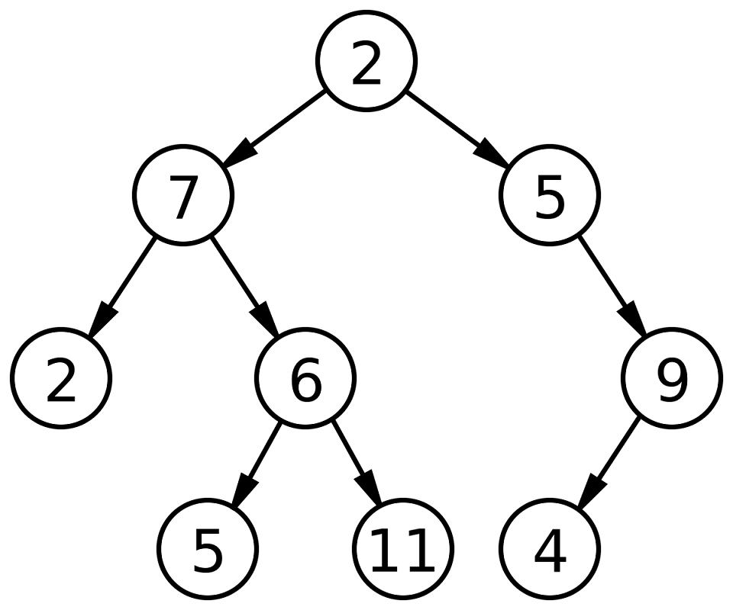
Binary tree (coming next)
Notes:
🌟 Purpose: Provide a preview of the next week's topic on binary trees, sparking curiosity and preparing students for the upcoming lesson.
✅ What should I be doing?
Briefly introduce binary trees and their importance in computer science.
Set the stage for next week’s session by explaining what students can expect to learn.
🎙 What should I be saying?
Next week, we’ll dive into binary trees, an essential data structure in computer science. Binary trees are used in various applications, such as searching, sorting, and organizing hierarchical data.
Each node in a binary tree has at most two children: a left child and a right child. This structure allows us to efficiently traverse and manipulate data.
For example, the tree shown here starts with the root node, 2, and branches into left and right subtrees. We’ll learn how to traverse trees, search for elements, and more.
This is a foundational topic that builds on our understanding of recursion and sets the stage for more advanced algorithms.
🙌🏽 How should I engage students?
Ask: "Looking at this tree, what do you notice about the structure? Why do you think binary trees might be useful in solving real-world problems?"
Encourage: "If you’re curious, think about how recursion might be applied to traverse this structure. Can you imagine calling a function recursively on the left and right children of a node?"
Build excitement: "Next week, we’ll also see how binary trees relate to practical applications like searching data faster than with a simple list."

Slide 16
Print binary tree (recursive)
def print_tree(node):
if node:
print(node.value)
print_tree(node.left)
print_tree(node.right)
Notes:
🌟 Purpose: Introduce a recursive method for traversing and printing a binary tree.
✅ What should I be doing?
Walk students through the recursive function print_tree.
Explain how the function uses recursion to traverse the tree in a pre-order traversal (root, left, right).
🎙 What should I be saying?
This example shows a recursive function to print the nodes of a binary tree. The method performs a pre-order traversal, where we visit the root node first, then recursively traverse the left subtree, followed by the right subtree.
The function takes a node as input. If the node exists, we first print its value. Then, we recursively call print_tree on the left child, and after that, on the right child.
In this tree, the traversal order would be 2, 7, 2, 6, 5, 11, 5, 9, 4.
Notice how the function calls itself for each child node. This demonstrates the power of recursion in working with hierarchical data structures like trees.
🙌🏽 How should I engage students?
Ask: "Looking at the function, can you identify the base case and the recursive case? Why are both essential for recursion to work?"
Encourage: "What do you think will happen if the tree is empty or if there’s only one node? Try visualizing this process."
Challenge: "Can you think of scenarios where recursion might not be the best choice for tree traversal?"

Slide 17
Print binary tree (iterative)
def print_tree(root):
stack = []
current = root
while stack or current:
while current:
stack.append(current)
current = current.left
current = stack.pop()
print(current.value)
current = current.right
Notes:
🌟 Purpose: Introduce an iterative method for traversing and printing a binary tree.
✅ What should I be doing?
Explain how the iterative approach uses a stack to simulate the recursion process.
Compare this approach to the recursive method from the previous slide.
🎙 What should I be saying?
This example shows an iterative way to traverse and print a binary tree. It uses a stack to simulate the recursion process.
We start by initializing an empty stack and setting the current node to the root. While there are still nodes to process in the stack or the current node isn’t null, we follow these steps:
First, we traverse to the leftmost node, pushing each visited node onto the stack.
When we can’t go left anymore, we pop a node from the stack, print its value, and then move to its right child.
This iterative approach achieves the same pre-order traversal as the recursive method, but without the risk of running out of stack space for deep trees.
🙌🏽 How should I engage students?
Ask: "Why do we use a stack in this method? How does it simulate the recursive call stack?"
Compare: "What are the advantages of using an iterative method over recursion for tree traversal? Can you think of any trade-offs?"
Encourage: "If you were to write a similar iterative function for post-order traversal, what changes would you need to make?"

Slide 18
Why Not Recursion?
It's confusing sometimes!
Iterative solutions are usually easier to understand and debug for students.
In reality, recursion is more commonly used to test conceptual understanding in interviews rather than in production code, where iterative solutions are usually preferred for clarity and traceability.
Notes:
🌟 Purpose: Discuss the limitations and challenges of recursion.
✅ What should I be doing?
Explain why recursion can be confusing or less practical in some cases.
🎙 What should I be saying?
While recursion is powerful, it can also be confusing. Tracing recursive calls and debugging recursive functions is often harder than working with iterative solutions.
In practice, recursion is more commonly used to test conceptual understanding in interviews rather than in production code, where iterative solutions are usually preferred for clarity.
🙌🏽 How should I engage students?
Ask: "What challenges have you faced when working with recursion? How did you overcome them?"

Slide 19
Example: Factorial
Implement a method to calculate the factorial. What is the base case?
5! = 5 * 4 * 3 * 2 * 1
4! = 4 * 3 * 2 * 1
3! = 3 * 2 * 1
2! = 2 * 1
1! = 1
Notes:
🌟 Purpose: Introduce the factorial function as a simple example of recursion.
✅ What should I be doing?
Explain the factorial concept and why it’s a natural fit for recursion.
Walk students through how a recursive method can calculate the factorial.
🎙 What should I be saying?
Let’s look at an example of recursion: calculating the factorial of a number. The factorial of a number n, written as n!, is the product of all integers from 1 up to n.
For example, 5! = 5 * 4 * 3 * 2 * 1, which equals 120.
This problem is naturally recursive because we can break it down into smaller subproblems. For instance, 5! can be expressed as 5 * 4!, and 4! can be expressed as 4 * 3!, and so on.
The base case here is 1! = 1. Once we reach this point, the recursion stops, and the function returns the value 1.
🙌🏽 How should I engage students?
Ask: "Can anyone identify the base case and the recursive case in this example?"
Encourage: "Let’s think about what happens if we accidentally leave out the base case. What would happen to the function?"
Challenge: "If we were to implement this iteratively instead of recursively, how would the approach differ? Which do you think is more efficient for this specific problem?"

Slide 20
def factorial(n):
if n == 1:
return 1
else:
return n * factorial(n - 1)
factorial(5)
return 5 * factorial(4)
5 * 24 = 120
factorial(4)
return 4 * factorial(3)
4 * 6 = 24
What is the result of factorial(5)?
factorial(3)
return 3 * factorial(2)
3 * 2 = 6
120
factorial(2)
return 2 * factorial(1)
2 * 1 = 2
factorial(1)
return 1
Notes:
🌟 Purpose: Demonstrate a real-world example of recursion using the factorial function.
✅ What should I be doing?
Walk through the implementation of the factorial function and trace its recursive calls.
🎙 What should I be saying?
Here’s a classic example of recursion: calculating the factorial of a number. The factorial of n is defined as n * (n-1) * (n-2) ... * 1.
Using recursion, we define factorial(n) as n * factorial(n-1) with the base case being factorial(1) = 1.
Let’s trace the function calls step by step to see how the recursive calls stack and resolve.
🙌🏽 How should I engage students?
Ask: "Can you identify the base case and recursive case in this function? Why is each important?"

Slide 21
Binary Search - Activity
The binary search algorithm finds a target element in a sorted list by dividing the list in half in each iteration.
60
5
10
0
60
5
10
0
20
1
20
1
30
2
30
2
40
3
50
4
50
4
low
mid
low
mid
mid
high
Target: 40
Notes:
🌟 Purpose: Introduce binary search as an example of recursion in action.
✅ What should I be doing?
Explain the recursive nature of binary search and walk through the function.
🎙 What should I be saying?
Binary search is a classic example of recursion. It works by dividing a sorted array into halves and searching in the relevant half.
The recursive case involves checking whether the middle element is the target, and if not, calling the function on either the left or right half of the array.
🙌🏽 How should I engage students?
Ask: "Why is binary search more efficient than linear search? How does recursion simplify its implementation?"

Slide 22

Break Time!
Take 5 mins to step away from the computer. Feel free to turn off your camera and return promptly after 5 mins.
Notes:
🌟 Purpose: Provide a short break to refresh and re-energize.
✅ What should I be doing?
Announce the break and remind students to return on time.
Play the countdown timer video (be sure to share sound).
🎙️ What should I be saying?
Let’s take 5 minutes to step away from the screen. Be sure to return promptly.

Slide 23
Collaborative Problem Solving
60 minutes

Slide 24
60 minutes
🏃🏽 Navigate to your breakout room.
👋🏽 Introduce yourselves!
🧑🏽‍💻 Work on the problems for your selected unit.

Slide 25
Wrap Up
10 minutes

Slide 26
Notes:
🌟 Purpose: End the session on a positive note.
✅ What should I be doing?
Prompt students to share their reflections in the chat.
🎙️ What should I be saying?
Let’s celebrate your wins. Share one good thing you learned or accomplished today!
🙌🏽 How should I engage students?
Read a few responses aloud and celebrate with enthusiasm.

Slide 27


Session Survey Time!
Notes:
🌟 Purpose: Gather feedback to improve future sessions.
✅ What should I be doing?
Share the survey link and emphasize its importance.
🎙️ What should I be saying?
Your feedback helps us make these sessions even better. Please take a moment to complete the survey.
🙌🏽 How should I engage students?
Thank students for their input and explain how feedback has been used in the past.

Slide 28

Final Reminders
Finish the problem sets for additional practice
Take the weekly HackerRank assessment by Sunday @ midnight
Visit a Study Hall Session to deepen your understanding, work through challenges, and connect with course material alongside your peers!
Notes:
🌟 Purpose: Reinforce key tasks and deadlines.
✅ What should I be doing?
Summarize next steps and encourage continued engagement.
🎙️ What should I be saying?
Don’t forget to complete the problem sets and take the HackerRank assessment by Sunday!
🙌🏽 How should I engage students?
Encourage students to ask any lingering questions before signing off.

